Slide 1





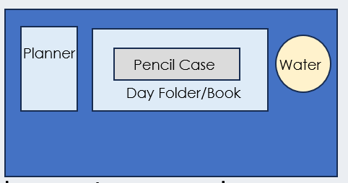



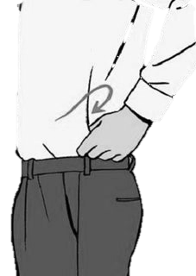


After the register, I am checking your….
Desk
Uniform
SLANT
All subject books go into your bag
(not floor or shelf!)
Notes:
This is you setting your expectation – issue demerits for uniform/equipment if they do not meet your expectation after this.

Slide 2







Read Now
Sunday 11 January 2026
Taking It Further: Pyramids of Biomass
Task:
Complete the Read Now by:
Stick in the sheet.
Using a highlighter as you read to identify key terms.
Answer the first four recall questions under the sheet in your book.
Answer the stretch question
Aim High | Work Together | Be Kind | Lead the Way

Slide 3

Read Now
Answers:
C. Producers
Photosynthesis
Rabbit (also acceptable: insect, snail)
at the top of the pyramid
The amount of biomass gets smaller as you move up the pyramid.
The consumers would die or decrease in number because they would have no food to eat.
Aim High | Work Together | Be Kind | Lead the Way

Slide 4
Daily Review
Follow your teachers instructions:
“When I say go show me a MWB and a MWB Pen”
You will have 10 seconds for each question.
Hold your MWB in the Ready position
“Show me”
You need to score 70% to pass
Subtitle ‘test score’ ?/10
Aim High | Work Together | Be Kind | Lead the Way
Notes:
Teachers remember to input the quiz score

Slide 5
MWB Quiz
1)What is the rate of change of velocity?
2) What is the term for slowing down (also known as negative acceleration)
3) What is the unit for acceleration?
4) What term describes something that is not moving?
5) What is the distance covered per unit time?

Slide 6
MWB Quiz
What is the rate of change of velocity? | Acceleration
What is the term for slowing down, also known as negative acceleration. | Deceleration
What is the unit for acceleration? | (m/s²)
What term describes something that is not moving? | Stationary
What is the distance covered per unit time? | Speed

Slide 7

Following this lesson, students will be able to:
Identify the levels of a pyramid of biomass in terms of producers and consumers
State the approximate efficiency biomass transfer between trophic levels
Explain the energy losses between trophic levels
Key Words:
biomass
trophic level
thermoregulation
efficiency
Notes:
Can be edited depending on class need.

Slide 8

Biomass
Word:
Comes from:
Bio-
-mass
‘living’
‘amount of matter’
Definition:
Biomass is a measure of the total quantity of organic (living or recently dead) material
Notes:
Purpose: introducing new knowledge
Suggested guidance: ‘biomass’ – bio meaning living thing and mass (which they should know from P1.2) meaning the amount of matter in a substance.
Organic material refers to anything based on carbon compounds, which is not a definition pupils need at this level. Ensure they are aware that it is dry mass.

Slide 9
Pyramids of Biomass
A pyramid of biomass is a graphical representation of biomass at each trophic level
Biomass is lost between trophic levels as energy is lost between levels
Lion
Lion = 2 x 300 kg
Biomass of lion = 600 kg
Zebra
Grass
Zebra = 25 x 200 kg each
Biomass of zebra = 5 000 kg
20000
Grass = 10 000 000 blades x 5 g each
Biomass of grass = 50 000 kg
5000
25 000
25 000
10 000
0
5000
20 000
15 000
15 000
10 000
Biomass (kg)
Notes:
Purpose: introducing new knowledge
Type of exposition: explanation
Suggested Script:
A pyramid of biomass can be used to represent the biomass at each trophic level. What is a trophic level? An organism’s position in the food chain e.g. grass is trophic level 1, zebra would be 2. The width of the bar is proportional to the biomass at each level. Pyramids can be drawn with a scale often using graph paper. As you can see from the pyramid As you go through the trophic levels biomass is lost. This means that pyramids of biomass are always widest at the bottom and narrowest at the top- always giving a pyramid shape.
Additional information for teachers:
Pupils may have seen pyramids of numbers in KS2 and B1.3, which are useful for showing the relative populations of the species involved in food chains. However these do not offer much more information and are not always pyramid shaped – e.g. lots of insects and animals could be feeding off one tree. Pyramids of biomass are always pyramidal in shape.
Pupils should know that a trophic level is a stage/species in a food chain (full definition: each of several hierarchical levels in an ecosystem, consisting of organisms sharing the same function in the food chain and the same nutritional relationship to the primary sources of energy).

Slide 10
Pyramids of Biomass
Producers are always at the bottom of a pyramid of biomass
Producers are mostly plants and algae, which transfer approximately 1 % of the light energy they absorb for photosynthesis
Only around 10 % of the biomass from each level is transferred to the next level
Biomass is lost through:
Not all material is ingested or absorbed
Some absorbed material is lost as waste
Some is lost because energy is used
for life processes
Movement
Thermoregulation
Lion
Zebra
Grass
Notes:
Purpose: introducing new knowledge
Type of exposition: explanation
Suggested Script:
As we just said, producers are found at trophic level 1 and are therefore at the bottom of the pyramid of biomass. Ask before second bullet point comes up: Where do producers get their energy/food from? Producers produce their own food through photosynthesis using energy from sunlight.
Producers are only able to use a small amount of sunlight that falls on them. Plants and algae will only transfer around 1% of the energy from sunlight into plant biomass. What store of energy (learnt in P1.3) is biomass counted as? Biomass is a chemical store of energy.
We have said that biomass is lost at each trophic level, in fact only around 10% of the biomass (energy) is passed onto the next trophic level. This is because biomass can be lost in a number of ways:
Material that is not absorbed is egested as faeces (which is then used by decomposers)
Some material that is absorbed is lost as a waste product. An example of this: glucose is absorbed and used in respiration. Some energy is released but CO₂ and water are also produced as a waste products. (CO₂ carbon based so is organic material that comes from biomass). Also urea is produced by the body which is a waste product.
Other biomass is lost because of life processes.
Movement – animals need to move for many life processes (referring to MRS GREN from B1.1) for example reproduction and getting nutrition; for example, an animal may need to move to hunt prey or to find seeds to eat.
Thermoregulation – the process by which the body maintains a constant temperature. Pupils covered warm blooded and cold blooded organisms in primary so the word thermoregulation may be new but they should have an understanding of the concept. Thermoregulation is often the greatest source of energy consumption.
Additional information for teachers:
This is Biology separate science content, including calculation of the percentage energy transfer, but is very useful for all pupils to know to further their understanding of food chains and energy transfer.
Note: Biomass and energy are used interchangeably in this section as biomass is a store of chemical energy.

Slide 11
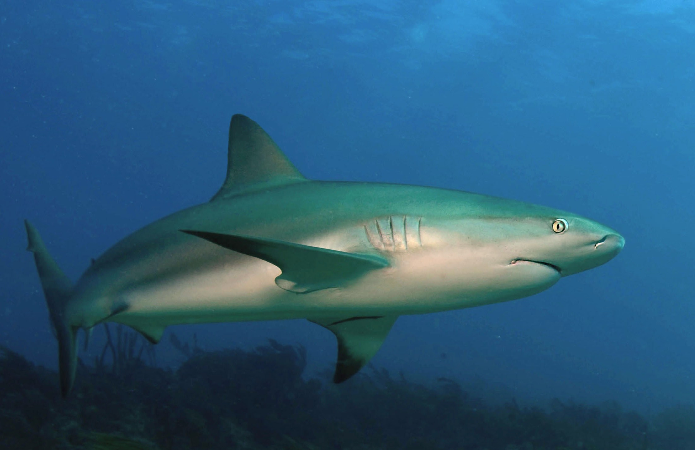
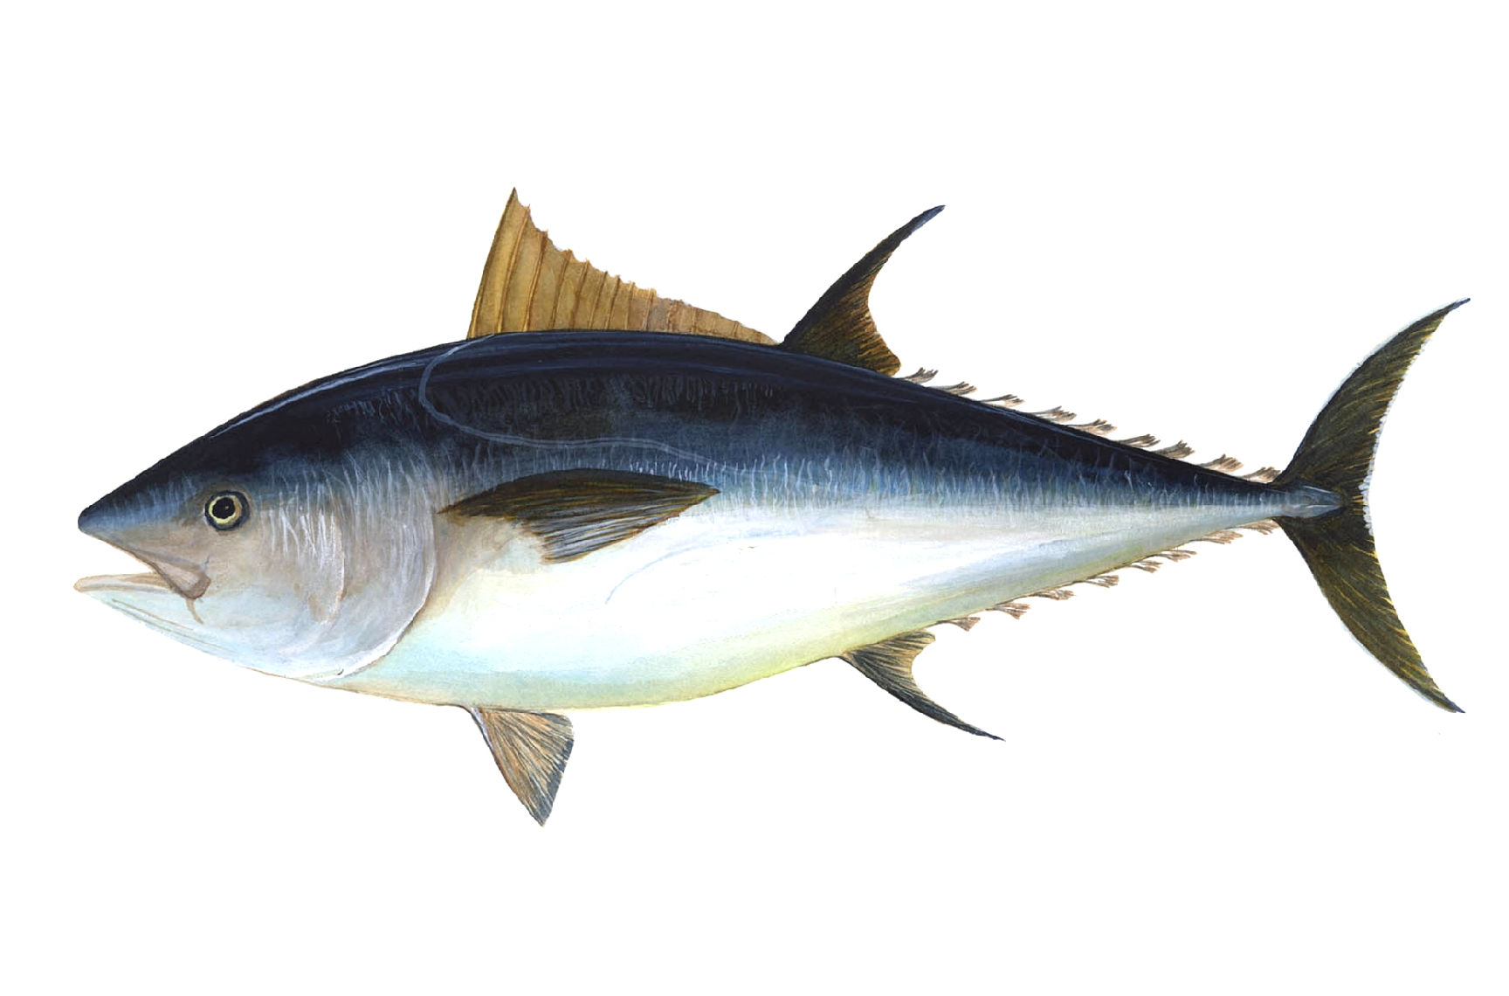
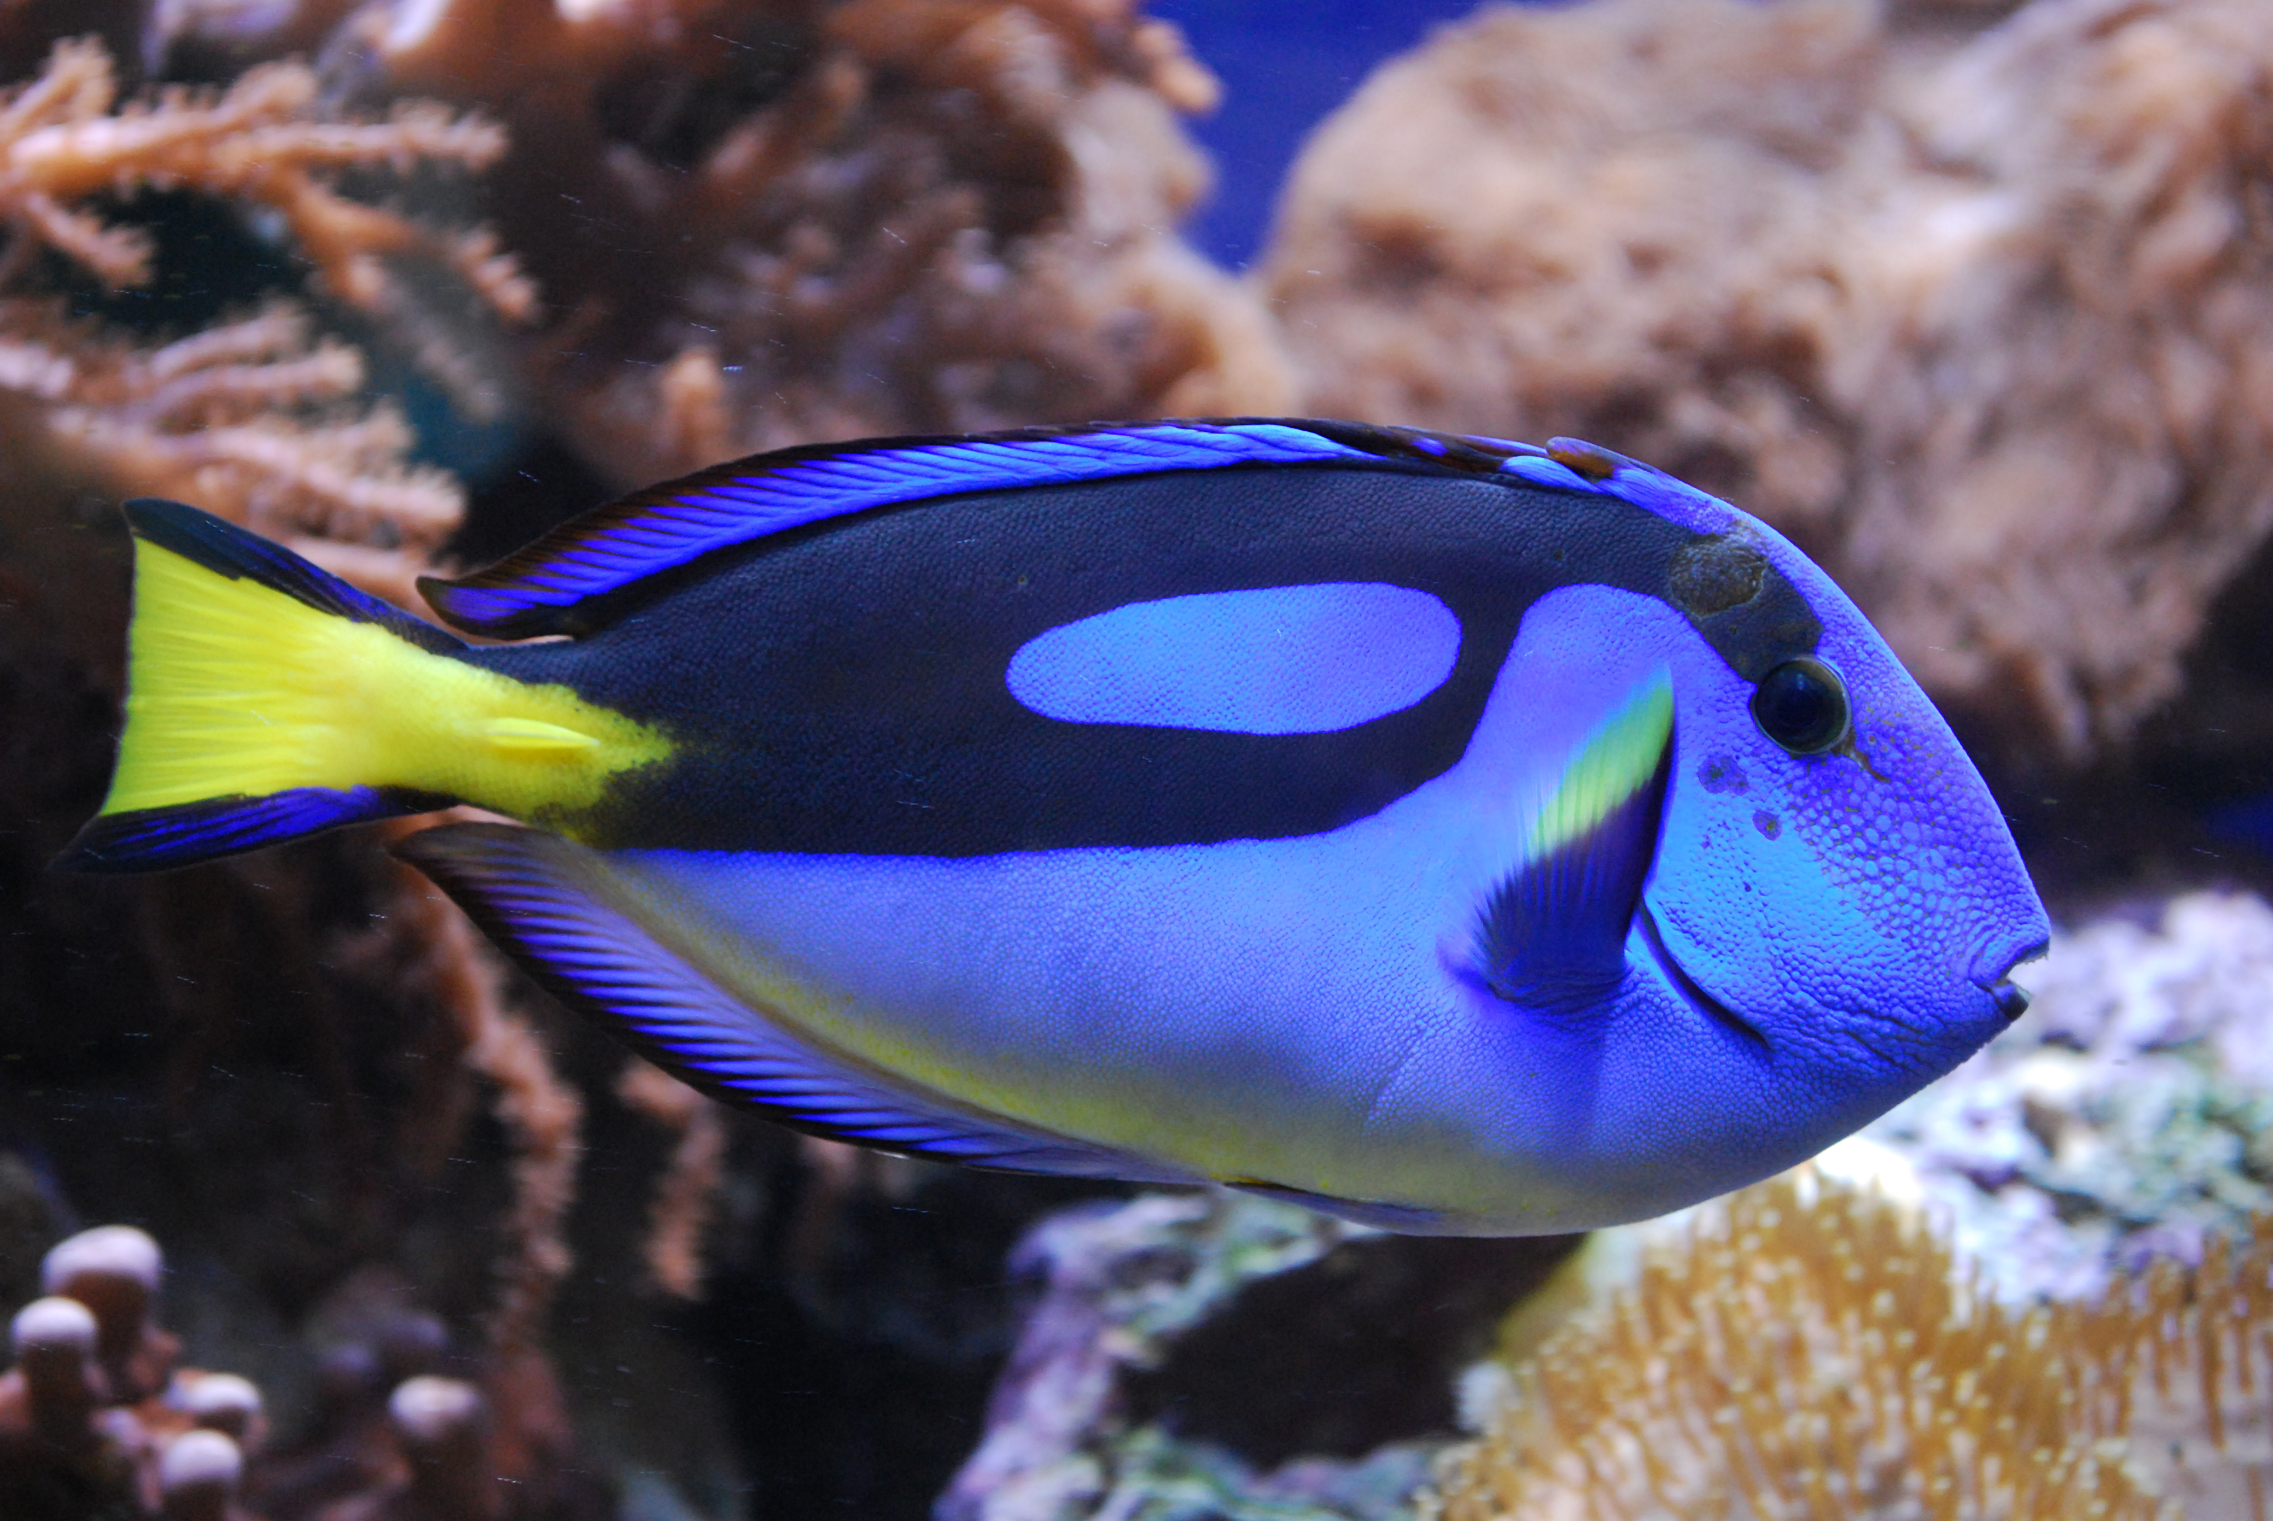
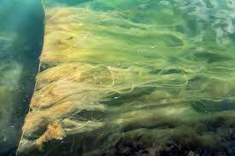
How many key science words can you add to this diagram?
What information can you get from it?
What terms can be used to describe each species?
What does this pyramid show?
Can you tell the number of each organism present?
What would happen if one of the species was affected by disease?
Why does the bar decrease at each level?
Reef shark
Tuna
Blue Tang
Algae
Notes:
Suggested guidance:
This example uses an aquatic food chain because often pupils assume pyramids of biomass only relate to foxes and rabbits etc, as they are the most commonly used examples. These species can be changed depending on the context of your class, but it is worth providing a picture or description of newly introduced species to give pupils a bit of context.
Opportunity for pupils to consolidate their prior learning from B1.3 and new knowledge from this lesson.
Questions are suggestions and can be edited depending on need but can be used to structure pupil conversations.
Key points to discuss:
Identifying producer, consumers, predators, prey, herbivore, carnivores etc
This shows a pyramid of biomass – a measure of the total organic material present in each trophic level
This does not show the number of individuals of each species, we would need a pyramid of numbers for that.
Depending which species was affected, the populations of other species would increase or decrease.
The bar decreases in width at each point because the biomass transfer is only 10% efficient – 90% of biomass is lost as waste and through life processes.
Image source
https://commons.wikimedia.org/wiki/File:Haai11.jpg
https://pixabay.com/photos/tuna-fish-bigeye-tuna-69317/
https://commons.wikimedia.org/wiki/File:Blue_tang_(Paracanthurus_hepatus)_02.jpg
https://commons.wikimedia.org/wiki/File:Marine_algae_stuck_on_a_rope_in_Gullmarsfjorden_2.jpg
Suggested guidance:
Talk tasks can be used in a variety of ways to suit the particular needs of the students you are teaching. Through exchanging views with others, students develop their understanding of the science beyond what could be achieved individually.
Science classrooms that successfully integrate talk have the following features:
Science talk is a regular feature of lessons and is woven into classroom activities.
Students are paired or grouped strategically by the teacher to ensure productive interaction. This might take into consideration the students’ proficiency of the English language, how encouraging they might be to peers and their attainment in the topic. It’s a good idea to consider these pairings in the class seating plan.
Students are encouraged and supported to talk, but are not forced to talk.
The teacher should take on the role of a facilitator, engaging with conversations where necessary and encouraging or steering the conversation where needed.
Students are encouraged to use the language they have to express their ideas (e.g., everyday language, imperfect English, native language), but also to incorporate science specific terminology where this is more accurate or has been taught.
6. Scientifically inaccurate ideas are not dismissed by the partner or teacher; open discussion and further investigation are relied on to help students construct ideas that support them to progress in their scientific understanding.
7. Guidelines for behaviour during talk tasks are explicit and frequently reviewed. Rules for students might be:
Listen carefully to your partner
Take turns talking.
Speak one at a time, without interrupting.
Politely agree or disagree and explain why.
Politely point out if your partner has used a scientific word incorrectly, if they have explained the science incorrectly, or if there is a more accurate way to describe something.
If confused, ask questions.
Stay focused on the discussion topic.
Respond to one another.

Slide 12


Quick Quiz
Determine if the following statements are true or false:
Producers are found at the top of pyramids of biomass
Producers are organisms that make their own food using sunlight
Approximately 10 % of biomass is lost between trophic levels
A pyramid of biomass is a representation of the number of each. organism present in the food chain
True False
False
True
False
False
Notes:
Purpose: review of new information.
Use thumbs up/down. Allow thinking time and 3,2,1 to prevent copying. Cold call or snowball questioning to explain why statements are true or false and correct false statements. Ensure that answers that are not completely correct are challenged.
Answers:
False – producers are at the bottom, the highest consumer/apex predator is at the top
True
False – only about 10 % of biomass is passed on to the next level
False– this would be a pyramid of numbers. A pyramid of biomass takes into account the number of organisms and the mass of each one, so it is a measure of the total living mass of each trophic level.

Slide 13
Efficiency of Biomass Transfers
The efficiency of biomass transfers is a measure of how much biomass has been transferred from one trophic level to another (and how much has therefore been wasted)
Percentage efficiency transfer = biomass in higher trophic level x 100
biomass in lower trophic level
Lion
Zebra
Grass
Notes:
Purpose: introducing new knowledge
Type of exposition: explanation
Suggested Script:
When looking at how much biomass moves from one trophic level to another we take into account how much biomass has been transferred compared with how much has been wasted. This means we are calculating the efficiency of a transfer. We calculated the efficiency of energy transfers bac in P1.3 when we studied energy in y7. How do we calculate the efficiency of an energy transfer? Useful energy output /total energy input x 100.
Remember, biomass is a type of chemical energy therefore we calculate the efficiency of a biomass transfer in a very similar way. We take the biomass in the higher trophic level (like useful output) and divide by the biomass in the lower trophic level (like total energy input) then to get a percentage as our answer we multiply by 100.
Additional information for teachers:
This is Biology separate science content, including calculation of the percentage energy transfer, but is very useful for all pupils to know to further their understanding of food chains and energy transfer.
For scaffolding support, you may want to leave this slide showing as they are completing the worksheet.
Biomass of lion and zebra from example on slide 5.

Slide 14
Efficiency of Biomass Transfers
Percentage efficiency transfer = biomass in higher trophic level x 100
biomass in lower trophic level
Example: Calculate the percentage efficiency transfer between zebra and lion.
Biomass of Zebra = 5000 kg Biomass of Lion = 600 kg
Percentage = biomass in higher trophic level (lion) x 100
Efficiency biomass in lower trophic level (zebra)
Transfer
= 600 x 100
5000
= 12 %
Lion
Zebra
Grass
Notes:
Purpose: introducing new knowledge
Type of exposition: modelling
Suggested Script:
So here we have an example pyramid of biomass to calculate efficiency with. We need to calculate the efficiency transfer between the zebra and lion. Arrow to or circle the zebra and lion trophic levels on the pyramid.
Which animal is in the higher trophic level? Lion. So Lion is in the higher level therefore we take its biomass (600kg) and we divide by the biomass of the zebra (5000kg) and multiply by 100. That gives us an answer of 12% which makes sense as we said earlier that approximately 10% of biomass is transferred from one trophic level to another.
Additional information for teachers:
To scaffold this, you could write out lion/zebra from the pyramid and then substitute in the numbers from there.
You could link this in with why food chains often have no more than 4 (occasionally 5) trophic levels. Get pupils to calculate how much biomass (at 10% transfer) would be passed on to a predator of a lion. They will see it is only 60kg. Then ask them what kind of predators would be strong and powerful enough to hunt lions if they are only going to gain 60Kg from doing so? None hence why there aren’t any predators. Food chains do not have more than 4 or 5 trophic levels because so much biomass is lost at every stage.
This is Biology separate science content, including calculation of the percentage energy transfer, but is very useful for all pupils to know to further their understanding of food chains and energy transfer.
Biomass of lion and zebra from example on slide 5.

Slide 15
Drill
Define biomass
What is a pyramid of biomass?
State what happens to the biomass between each trophic level.
Approximately how much biomass is transferred between each tophic level?
Give one reason as to why this happens
What is a producer?
State where producers are always found in a pyramid of biomass
Notes:
Purpose: This is a knowledge drill. The purpose of this is to check that the critical knowledge is secure before pupils move onto independent practice.
Suggested guidance: There are a range of ways this could be done depending on time and ability range of the class:
Mini whiteboards
As full sentences in exercise books
As short answers in exercise books
In the pupil workbook
As pair talk
As cold call

Slide 16
Drill answers
Biomass is a measure of the total quantity of organic (living or recently dead) material
A graphical representation of biomass at each trophic level
Biomass is lost between trophic levels as energy is lost between levels
Approximately 10%
Not all material is ingested/absorbed, some absorbed material is lost as waste, some is lost because energy is used for life processes like movement.
Producers are organisms that make their own food (plants).
Producers are always at the bottom of a pyramid of biomass
Notes:
Purpose: This is a knowledge drill. The purpose of this is to check that the critical knowledge is secure before pupils move onto independent practice.
Suggested guidance: There are a range of ways this could be done depending on time and ability range of the class:
Mini whiteboards
As full sentences in exercise books
As short answers in exercise books
In the pupil workbook
As pair talk
As cold call

Slide 17

I: Explain using scientific understanding to make something clear or state the reason for something happening
Example question:
To ‘explain’ your answer should:
Begin with a scientific statement.
Use ‘this means that’, ‘because’ or ‘so’ to link your statement to the question.
Birds eat insects.
Explain why the biomass of the insects eaten by birds does not all become biomass of the birds.
Model answer:
Not all material is ingested/absorbed
Some biomass is lost as waste
Some biomass is lost because energy is used for life processes
E.g. Movement or thermoregulation
Notes:
This slide models the process of answering an explain question.
Firstly, students are presented with a generic explain question, along with a model answer. Students are also given some simple guidance to follow for producing their own describe answer.
The generic question and answer should be used by the teacher to remind students of
the key features of a great answer
how to structure their answer
why the model answer is a good example
Following this, students will be required to apply this process to answer their own explain question, which will appear in place of the generic questions. This explain question will be specific to the topic students are learning about in the lesson. Give students time to write their own answer to this, ensuring that they use the guidance provided. To further scaffold this task for students, it may be appropriate to:
pair students up to write an answer together
list for students the key words you would like them to include in the answer
provide a writing frame or ‘points to include’ for students
A model answer for this question will appear. Teachers should review the model answer with students by referencing the guidance in the green box. For example ‘we can see item 1 in the guidance is to begin with a scientific statement. Notice in the model answer here we have done just that’. Or ‘item 2 in the guidance here says that we should use a linking statement in the answer. Has this been achieved in the model answer? Where can we see this?’.

Slide 18
We: Explain using scientific understanding to make something clear or state the reason for something happening
Example question:
To ‘explain’ your answer should:
Begin with a scientific statement.
Use ‘this means that’, ‘because’ or ‘so’ to link your statement to the question.
Explain as fully as you can, what eventually happens to energy from the sun which is captured by the plants in a woodland.
Model answer:
Some energy stored in cells/used to make other molecules
Some energy used for movement
Some energy lost as head
Some energy passed up food chain
Less energy stored at each stage in food
Some energy lost in waste
Some energy transferred to detritus feeders
All returned to environment
Notes:
This slide models the process of answering an explain question.
Firstly, students are presented with a generic explain question, along with a model answer. Students are also given some simple guidance to follow for producing their own describe answer.
The generic question and answer should be used by the teacher to remind students of
the key features of a great answer
how to structure their answer
why the model answer is a good example
Following this, students will be required to apply this process to answer their own explain question, which will appear in place of the generic questions. This explain question will be specific to the topic students are learning about in the lesson. Give students time to write their own answer to this, ensuring that they use the guidance provided. To further scaffold this task for students, it may be appropriate to:
pair students up to write an answer together
list for students the key words you would like them to include in the answer
provide a writing frame or ‘points to include’ for students
A model answer for this question will appear. Teachers should review the model answer with students by referencing the guidance in the green box. For example ‘we can see item 1 in the guidance is to begin with a scientific statement. Notice in the model answer here we have done just that’. Or ‘item 2 in the guidance here says that we should use a linking statement in the answer. Has this been achieved in the model answer? Where can we see this?’.

Slide 19
You: Explain using scientific understanding to make something clear or state the reason for something happening
Example question:
To ‘explain’ your answer should:
Begin with a scientific statement.
Use ‘this means that’, ‘because’ or ‘so’ to link your statement to the question.
Explain why farmers make more profit from keeping pigs indoors than keeping pigs outdoors
Model answer:
Less energy wasted on movement or less heat lost
So, pigs grow more/get bigger
Notes:
This slide models the process of answering an explain question.
Firstly, students are presented with a generic explain question, along with a model answer. Students are also given some simple guidance to follow for producing their own describe answer.
The generic question and answer should be used by the teacher to remind students of
the key features of a great answer
how to structure their answer
why the model answer is a good example
Following this, students will be required to apply this process to answer their own explain question, which will appear in place of the generic questions. This explain question will be specific to the topic students are learning about in the lesson. Give students time to write their own answer to this, ensuring that they use the guidance provided. To further scaffold this task for students, it may be appropriate to:
pair students up to write an answer together
list for students the key words you would like them to include in the answer
provide a writing frame or ‘points to include’ for students
A model answer for this question will appear. Teachers should review the model answer with students by referencing the guidance in the green box. For example ‘we can see item 1 in the guidance is to begin with a scientific statement. Notice in the model answer here we have done just that’. Or ‘item 2 in the guidance here says that we should use a linking statement in the answer. Has this been achieved in the model answer? Where can we see this?’.

Slide 20
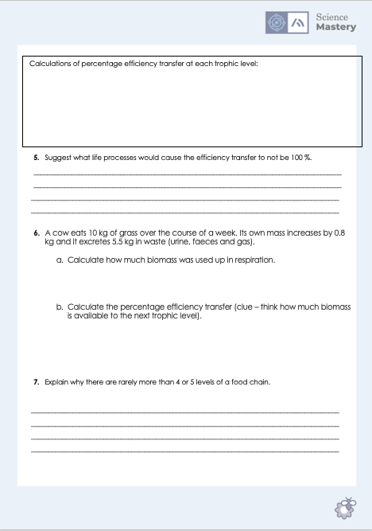
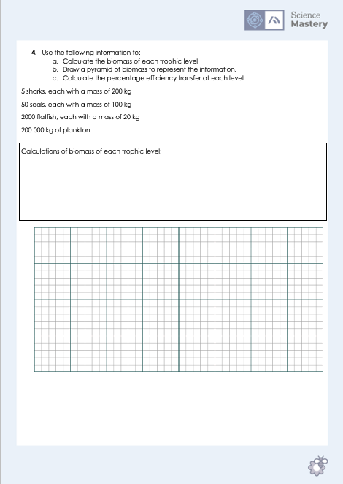
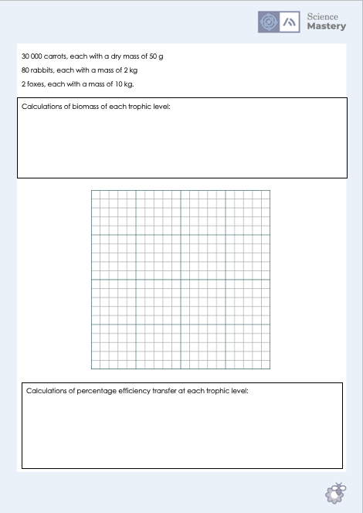
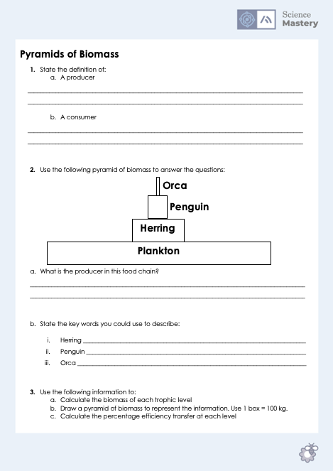
Pyramids of Biomass
Complete the Pyramids of Biomass worksheet
Use a pencil and ruler for any drawing
Show working for all calculations
Notes:
Purpose: application of new information.
Key skill/concept here is the percentage calculation but you may find that some pupils take a long time to complete their pyramids. Some will also try to count the boxes from the left hand side and end up with a histogram shape rather than a pyramid – ensure they know to start from the middle. For weaker classes/pupils it may be worth giving them a copy of the pyramid rather than getting them to draw it themselves or going through each stage (i.e. calculating the biomass, determining the number of boxes that should fill etc).
You may also want to show pupils pictures of the different organisms (i.e. herring and orca) if they are unfamiliar with them.
Alternative/Stretch activity:
Ectothermic animals (such as fish and reptiles) transfer biomass much more efficiently than endotherms (such as mammals), meaning that endotherms have to consume greater quantities than ectotherms. Suggest an explanation for this.

Slide 21
Answer the questions below.
Which is the best description of a pyramid of biomass?
A. A representation of the number of organisms in each trophic level
B. A diagram to show how big each organism is compared to others
C. A representation of the amount of biomass in each trophic level
2. Which best explains why only approximately 10 % of biomass is passed on to the next trophic level?
A. The rest of the biomass is released as waste urine and faeces
B. Biomass is lost at each trophic level through waste and life processes
C. Each trophic level needs to keep the rest of the biomass for themselves
3. Which best explains why food chains rarely have more than 5 levels?
A. The apex predators cannot get any bigger
B. Only approximately 10 % of biomass is passed on to the next trophic level
C. Only half the biomass is passed on so it will eventually run out
✓
✓
✓
Notes:
Q1. Answer: C
If students answer A, they have mixed up with a pyramid of numbers. If they answer B, they have thought about individual organisms and not taken the number of organisms into account.. To fix-it, they may need a further recap of the features of a pyramid of biomass versus a pyramid of numbers. It may be useful to show an example of a large producer (e.g. a tree) which has a small representation on a pyramid of numbers but a large representation on a pyramid of biomass.
Q2. Answer: B
If students answer A or C, they are struggling with the idea that majority of biomass is used within the trophic level, either in life processes (respiration for heat and movement) or lost as waste. . To fix-it they may find it useful to practice further calculation questions (such as with missing values for respiration or waste) so that they can work out how much is wasted and how much is passed on. It may be useful to remind them of the energy efficiency = useful output/total input energy (x100) equation in physics and showing them that it is the same. For some pupils the misconception is that they will not view heat and movement as waste (because the organism in that trophic level needs them) in terms of higher trophic levels.
Q3. Answer: B
If students answer A or C, they are struggling with the idea that majority of biomass is used within the trophic level, either in life processes (respiration for heat and movement) or lost as waste. To fix-it, they may find it useful to practice further calculation questions (such as with missing values for respiration or waste) so that they can work out how much is wasted and how much is passed on. It may be useful to remind them of the energy efficiency = useful output/total input energy (x100) equation in physics and showing them that it is the same. For some pupils the misconception is that they will not view heat and movement as waste (because the organism in that trophic level needs them) in terms of higher trophic levels.

